Slide 1
SQL Basics (ALTER, Update, delete,truncate,DROP, OPERATORs)
Afreenzehra sayed

Slide 2
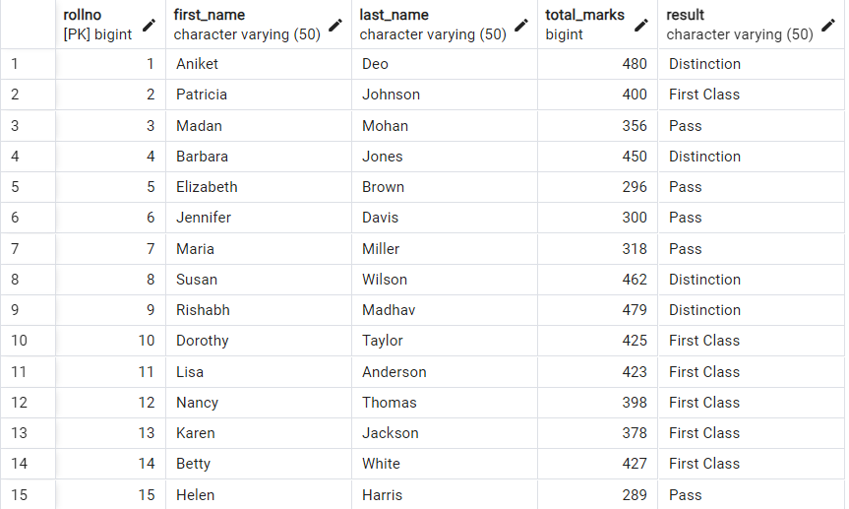
created Table student_details in the database students
Note: Create this table by refering my previous post

Slide 3
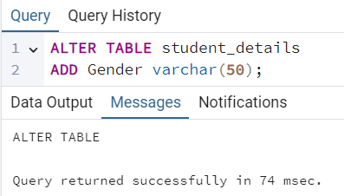
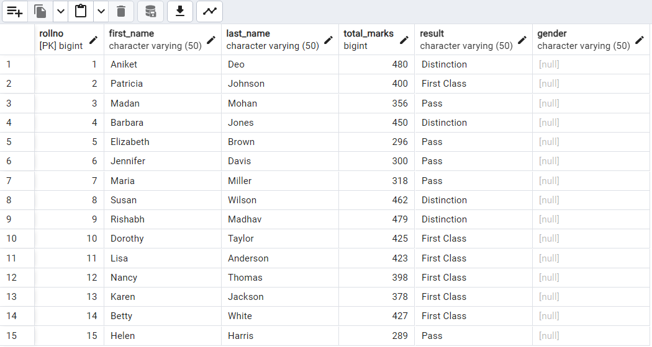

ADD column using ALTER Statement
STEP 1
STEP 2
Note: The Gender column shows null as we have not yet added any values

Slide 4
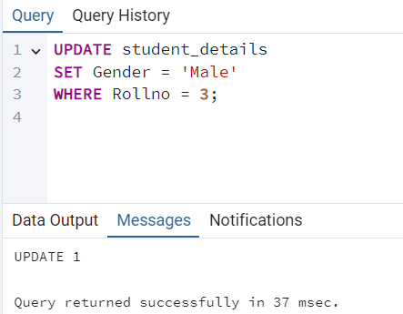
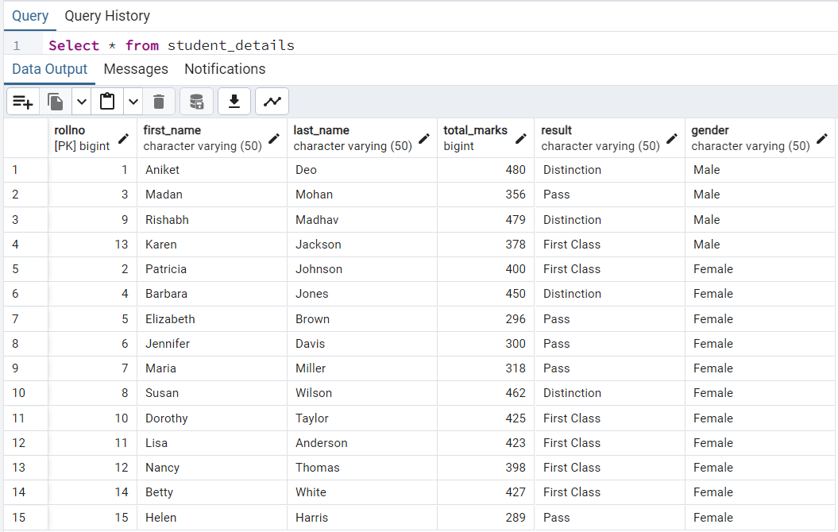
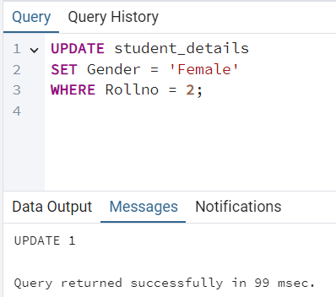
UPdate Statement
STEP 1
STEP 2
Note: The Gender column shows null as we have not yet added any values
Note: Repeat Step 1 & 2 to update all the rows then write Select statement to get the below table

Slide 5
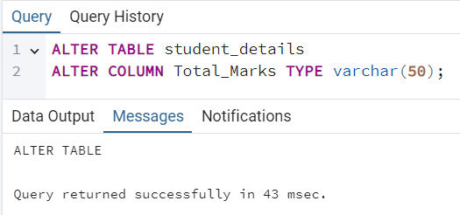
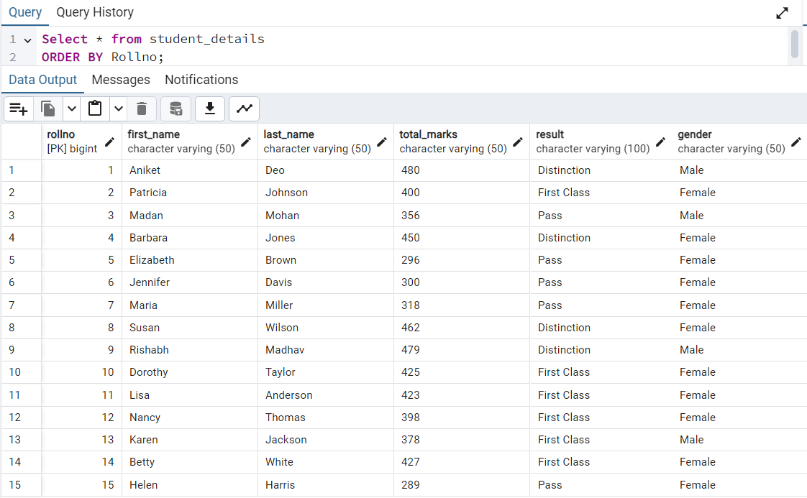
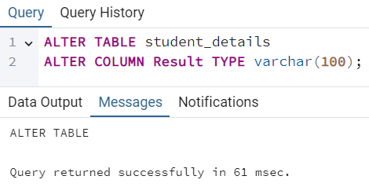
Alter Statement to Modify COLUMN
1. This query will modify int type to varchar
2. This query will change the max allowed characters from 50 to 100 for Result column
Note: Some data types cannot be converted if the column has value. E.g. numbers can always be converted to text, but text cannot always be converted to numbers.

Slide 6
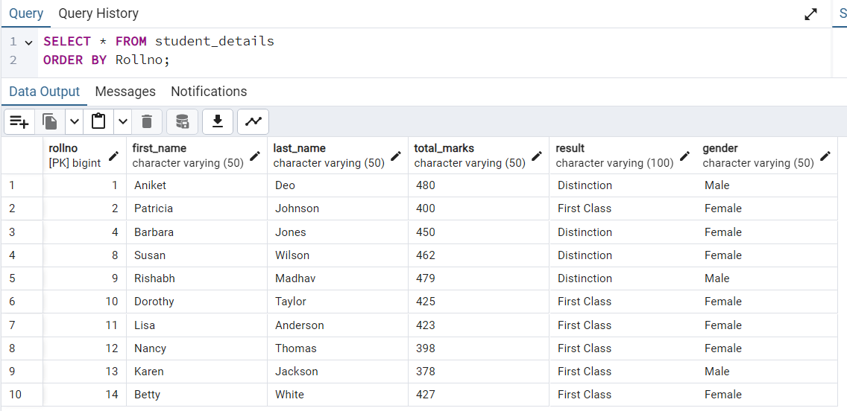
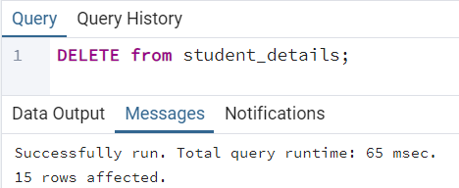
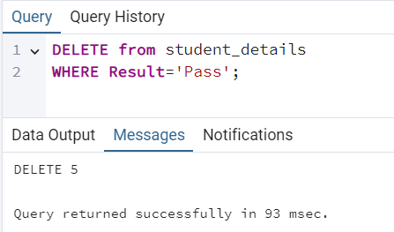
DELETE statement
1. This query will delete all records from the table while keeping intact table structures, attributes and indexes . Be careful while executing it.
2. After executing delete with where clause. Execute Select with Order By for below table
2. This query will delete particular records mentioned in the where clause.

Slide 7
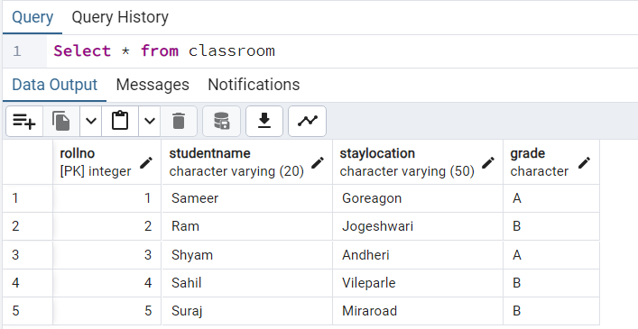
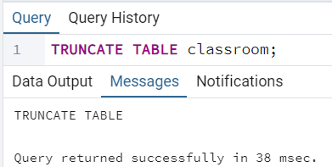
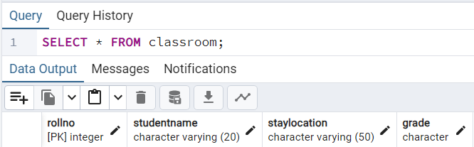
Truncate statement
1. Lets make a classroom table to perform these opeartions. The table is shown below
2. The TRUNCATE TABLE command deletes all the data inside the table , but not the table.

Slide 8
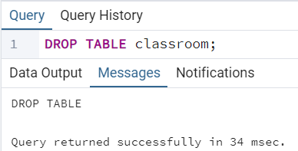
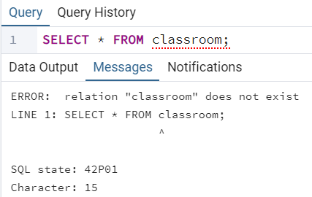
DROP statement
The DROP TABLE command deletes the entire table along with the structure in the database.

Slide 9
OPERATORS in SQL
We can operate with different operators in the WHERE clause:
= Equal to
< Less than > Greater than
<= Less than or equal to >= Greater than or equal to
!= Not equal to
LIKE Check if a value matches a pattern (case sensitive)
ILIKE Check if a value matches a pattern (case insensitive)
AND Logical AND
OR Logical OR
IN Compare a value with a set of values
BETWEEN Compare two values inside a range
IS NULL Check if a value is NULL
NOT Makes a negative result e.g. NOT LIKE, NOT IN, NOT BETWEEN

Slide 10
HELPFUL? REPOST

